Slide 1
CUSTOMER SEGMENTATION (CDACL– 002)
Introduction
Customer segmentation is the process of dividing customers into groups based on similar purchasing behavior, preferences, and shopping patterns. It helps businesses better understand their customers and deliver personalized products, services, and marketing campaigns. By using data analytics and machine learning techniques like K-Means clustering, organizations can improve customer satisfaction, retention, and overall business performance.
Submitted By:
Name: Bandaru Harika Hasini
Roll No: CA11202516329
Course: CDA

Slide 2
PROBLEM STATEMENT
Objective
Analyze customer shopping behavior using SQL, Python, and Power BI to identify business opportunities through customer segmentation.
Business Problems
Identify product categories suitable for discounts.
Analyze card spending across different age groups.
Study seasonal and regional purchasing behavior.
Segment customers into 3 or more groups using K-Means Clustering.
Recommend targeted marketing strategies based on customer behavior.

Slide 3
DATASET OVERVIEW
Dataset Description
The Customer Shopping Trends dataset contains 3,900 customer purchase records collected from the U.S. retail market. It includes customer demographics, purchase behavior, payment methods, seasonal trends, discounts, and shopping frequency. This dataset is used to analyze customer behavior, perform segmentation, and generate business insights.
Data Preparation
The dataset was prepared by checking for missing values, duplicate records, and data type inconsistencies to ensure data quality. Categorical variables were standardized, and age groups were created for better analysis and visualization. The cleaned dataset was then used for SQL analysis, Power BI dashboards, and K-Means clustering.

Slide 4
TOOLS USED
SQL (MySQL): Used to extract, query, and analyze customer shopping data.
Python: Used for data preprocessing, exploratory data analysis (EDA), and K-Means customer segmentation.
Power BI: Used to build interactive dashboards and visualize KPIs, trends, and business insights.
Microsoft Excel: Used for initial data inspection and basic validation before analysis.
Overall: These tools were used together to clean, analyze, visualize, and segment customer data, enabling data-driven business recommendations and targeted marketing strategies.

Slide 5
DATA CLEANING
Data cleaning is a crucial step in the data analysis process that improves the quality, consistency, and reliability of the dataset. Before performing SQL analysis, creating Power BI dashboards, and applying the K-Means clustering algorithm, the customer shopping dataset was carefully examined and cleaned to eliminate inconsistencies and ensure accurate results.
Data Cleaning Process
Data Quality Check: Verified the dataset for missing values, duplicate records, and validated data types to ensure data accuracy and consistency.
Data Transformation: Standardized categorical values, created age groups, and selected relevant features for analysis and customer segmentation.
Data Validation: Reviewed the cleaned dataset to ensure it was structured and ready for SQL analysis, Power BI dashboard creation, and K-Means clustering.

Slide 6
SQL ANALYSIS
SQL was used to extract, organize, and analyze customer shopping data stored in the database. Various SQL queries were executed to identify purchasing patterns, customer preferences, and business trends. The analysis helped transform raw transactional data into meaningful insights that support data-driven decision-making.
Analysis Performed
Analyzed revenue by product category, season, and location.
Examined customer spending by age group and payment method.
Evaluated the impact of discounts, promo codes, and subscription status.
Calculated key metrics such as total revenue, average purchase amount, and customer count.
Identified business insights to support customer segmentation and marketing strategies.

Slide 7
CUSTOMER SHOPPING TRENDS DASHBOARD
Interactive Dashboard Overview
The interactive Power BI dashboard provides a comprehensive overview of customer shopping trends and overall business performance. It combines key performance indicators (KPIs), charts, maps, and interactive filters to analyze customer demographics, purchasing behavior, seasonal sales, product category performance, and payment preferences. The dashboard helps identify high-performing products, customer spending patterns, and regional sales trends, enabling users to monitor business performance effectively. By presenting data through clear and meaningful visualizations, it supports data-driven decision-making, improves customer understanding, and assists businesses in developing targeted marketing strategies and enhancing overall sales performance.

Slide 8
CUSTOMER SHOPPING TRENDS DASHBOARD
DASHBOARD COMPONENTS
The chart illustrates the top industries actively recruiting Data Science professionals. Biotech and Pharmaceuticals lead the hiring market, followed by Insurance, Computer Hardware and Software, IT Services, and Healthcare organizations.
KPI Cards: Displays Total Customers, Revenue, Average Spend, Rating, Age, and Purchases.
Category Analysis: Shows revenue across different product categories.
Age Group Analysis: Compares average spending by customer age groups.
Seasonal Analysis: Displays sales performance across all seasons.
Location Analysis: Visualizes revenue distribution by location.
Payment Method Analysis: Shows customer payment preferences.
Purchase Frequency: Analyzes customer shopping frequency.
Interactive Filters: Enables filtering by Category, Gender, and Season.

Slide 9
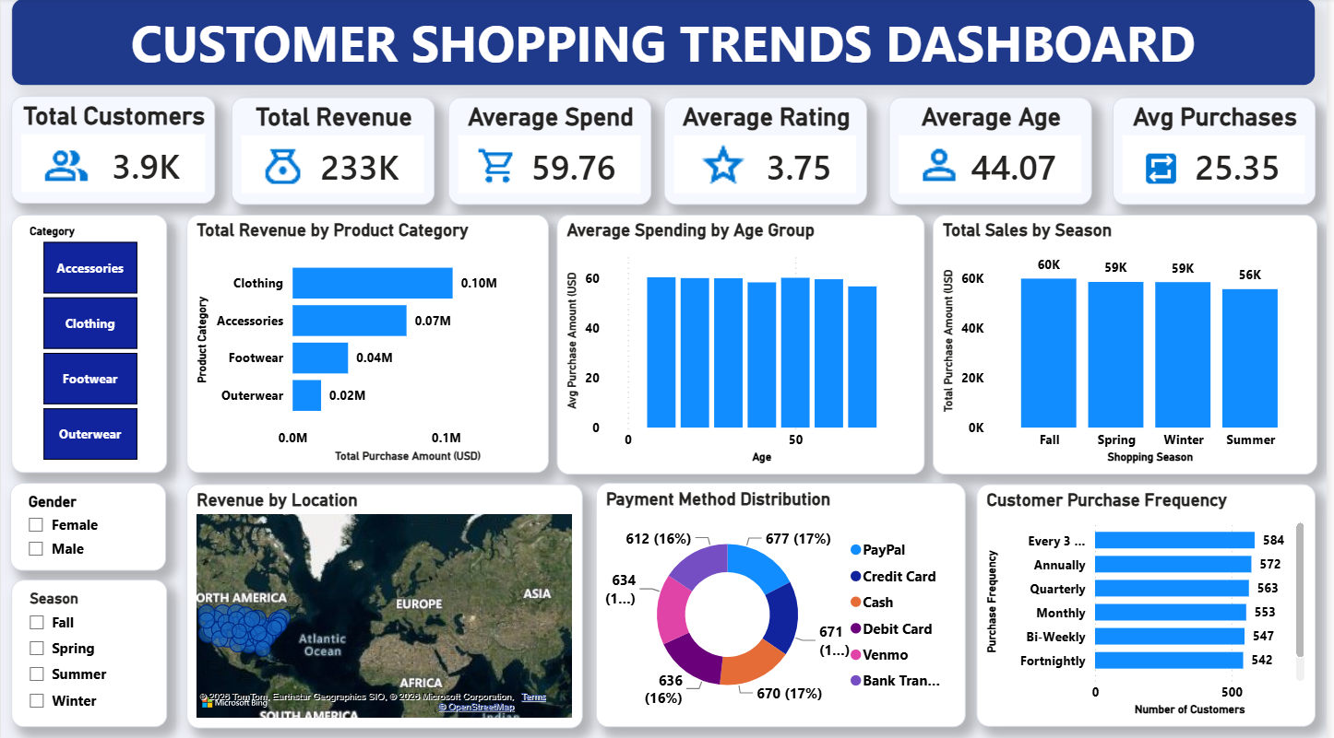
CUSTOMER SHOPPING TRENDS DASHBOARD

Slide 10
CUSTOMER SEGMENTATION & BUSINESS INSIGHTS
Interactive Dashboard Overview
The Customer Segmentation & Business Insights dashboard provides a comprehensive and interactive view of customer behavior, shopping trends, and overall business performance. It combines customer segmentation results with key business metrics to help identify purchasing patterns, spending habits, and customer preferences. Interactive charts, KPIs, maps, and slicers enable users to analyze customer clusters, product category performance, seasonal sales, payment methods, and regional trends. The dashboard also highlights high-value customers, evaluates the effectiveness of promotional strategies, and supports data-driven decision-making. These insights help businesses develop personalized marketing campaigns, improve customer retention, optimize sales strategies, and drive sustainable business growth.

Slide 11
CUSTOMER SEGMENTATION & BUSINESS INSIGHTS
Dashboard Components
KPI Cards: Displays Total Customers, Total Revenue, Average Purchase Amount, Average Rating, and Average Previous Purchases.
Customer Segmentation: Visualizes customer groups (Budget, Regular, and Premium) based on purchasing behavior using K-Means clustering.
Spending Analysis: Shows customer spending patterns across different age groups and payment methods.
Category & Seasonal Analysis: Highlights product category performance and sales trends across different seasons.
Geographical Analysis: Displays revenue distribution across various locations to identify high-performing regions.
Business Insights: Presents key findings on customer loyalty, shopping frequency, subscription status, and promotional effectiveness.
Interactive Filters: Allows users to filter data by Category, Gender, Season, Payment Method, and Customer Segment for detailed analysis.

Slide 12
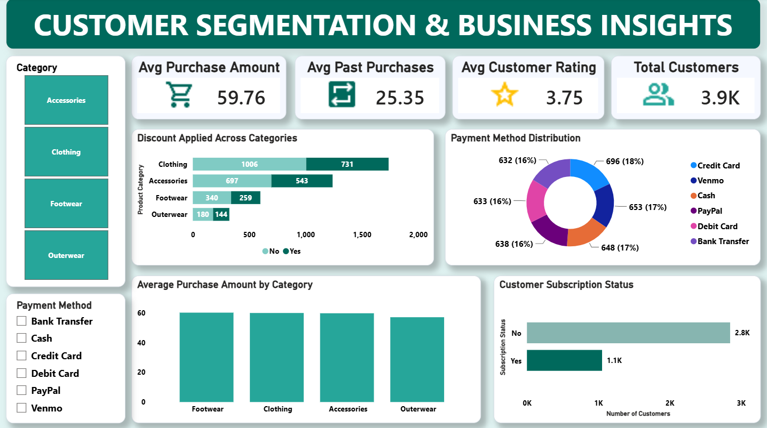
CUSTOMER SEGMENTATION & BUSINESS INSIGHTS

Slide 13
Customer Segmentation (K-Means Clustering)
Customer Segmentation
Customer segmentation is the process of dividing customers into groups based on similar purchasing behavior and shopping patterns. In this project, the K-Means Clustering algorithm was used to classify customers into three distinct groups. This helps businesses better understand customer needs and design personalized marketing strategies.
Algorithm Used
K-Means Clustering
Number of Clusters: 3
Platform: Python (Scikit-learn)
Features Used for Clustering
Age
Purchase Amount (USD)
Previous Purchases
Review Rating
Purchase Frequency

Slide 14
BUSINESS INSIGHTS
The analysis of customer shopping data revealed several valuable insights into customer behavior, spending patterns, and business performance. These insights help identify growth opportunities and support strategic business decisions.
Key Insights
Product Performance: Clothing and Accessories generated the highest revenue.
Customer Spending: Customers aged 26–35 had the highest average spending.
Seasonal Trends: Winter and Fall recorded higher sales than other seasons.
Payment Methods: Credit Card and PayPal were the most preferred payment options.
Customer Loyalty: Subscription customers made more frequent purchases.
Customer Segmentation: Customers were grouped into Budget, Regular, and Premium segments for targeted marketing.

Slide 15
RECOMMENDATIONS
Based on the analysis of customer shopping behavior, the following recommendations are proposed to improve customer engagement, increase sales, and support business growth.
Apply Targeted Discounts: Offer discounts on low-performing product categories to boost sales.
Personalized Marketing: Create campaigns for Budget, Regular, and Premium customer segments.
Strengthen Loyalty Programs: Reward frequent and subscription customers with exclusive offers.
Seasonal Promotions: Launch promotional campaigns during peak shopping seasons.
Optimize Payment Offers: Provide cashback and discounts for popular payment methods.
Focus on High-Value Customers: Offer premium benefits and personalized recommendations.
Regional Marketing: Develop location-specific campaigns based on customer purchasing trends.

Slide 16
CONCLUSION
This project successfully analyzed customer shopping behavior using SQL, Python, and Power BI to uncover valuable business insights. Through data cleaning, SQL analysis, interactive dashboards, and K-Means clustering, customers were segmented into meaningful groups based on their purchasing patterns and shopping behavior. The analysis revealed key insights into customer spending, seasonal trends, payment preferences, and product performance. These findings support data-driven business decisions, enable targeted marketing strategies, and help improve customer satisfaction, sales, and overall business growth. Overall, this project demonstrates how data analytics and customer segmentation can help businesses make informed, data-driven decisions, optimize marketing efforts, and build stronger customer relationships for long-term growth.

Slide 17
THANK YOU

